Slide 1
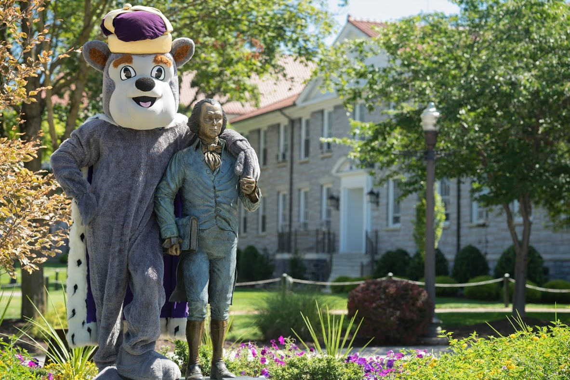
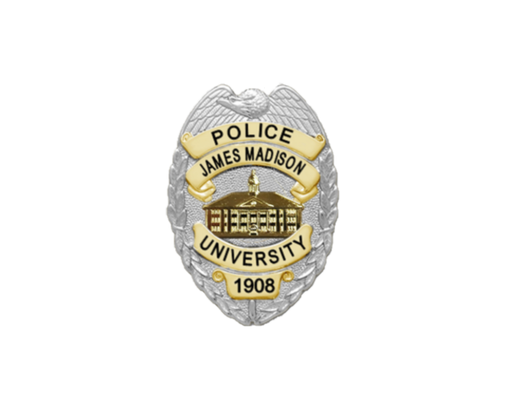
CAMPUS SECURITY AUTHORITY (CSA) TRAINING
CAMPUS SECURITY AUTHORITY (CSA) TRAINING
For University staff, faculty, contractors, and students with significant responsibility for student activities
Created by the Clery Compliance Coordinator in compliance with the Jeanne Clery Disclosure of Campus Security Policy and Campus Crime Statistics Act (20 USC § 1092(f))

Slide 2
OBJECTIVES
Clery Act awareness
CSA reporting requirements
How to handle crime disclosure

Slide 3
Clery Act History
Named in memory of 19-year-old Lehigh University freshman, Jeanne Ann Clery, who was tragically raped and murdered in her residence hall room on April 5, 1986.
Her parents believed she and others would have been more cautious if they’d known about other violent crimes at Lehigh University.
1990 – Federal Law enacted: Crime Awareness and Campus Security Act amended the Higher Education Act (HEA) of 1965).
1998 – Renamed “Jeanne Clery Disclosure of Campus Security Policy and Campus Crime Statistics Act” (i.e., the “Clery Act”).

Slide 4
IMPACT OF THE CLERY ACT
Mandated a requirement for all colleges and universities that participate in federal financial aid programs to keep and disclose information about crime on and near their respective campuses.

Slide 5
PURPOSE OF THE CLERY ACT
Provide students, families, and employees with accurate, complete, and timely information about campus safety so that they can make informed decisions.
James Madison University provides campus safety information in a number of ways, including, but not limited to:
Alerting the campus community about significant emergencies or dangerous
situations and crimes that pose a serious or continuing threat to safety.
Disclosing safety and security policies in an annual security report.
Publishing a daily crime and fire log of all crimes and all fires in on-campus student housing facilities reported to Madison Police.
Collecting crime reports from Campus Security Authorities and local law enforcement and disclosing statistics to the public.

Slide 6
ROLE OF CAMPUS SECURITY AUTHORITIES (CSAs)
Not all crimes come to the attention of campus police.
Therefore, the Clery Act requires a collaborative effort to collect previously unreported crime statistics from all individuals and organizations associated with the university who have significant responsibility for student or campus activities.

Slide 7
DEFINITION OF CSA AT JMU
CSAs include all University faculty, staff, and contractors who are not Pastoral Counselors or Professional Counselors. Additionally, all students fulfilling duties requiring them to take action or respond to particular issues on behalf of the institution (e.g., Resident Advisors)
The Clery Act also identifies certain categories of students, other university employees, volunteers and contractors as CSA’s:
Non-police security staff responsible for monitoring university property, monitoring events, and providing escorts to include contract security and students.
People/offices designated under our policy as those to whom crimes should be reported – the JMU Police, Title IX, Human Resources and the Office of Accountability and Restorative Practice.
“Officials with significant responsibility for students and campus activities”. “Official” is defined as any person who has the authority and duty to take action and respond to particular issues on behalf of the institution to include Vice Presidents, Associate Vice Presidents, Assistant Vice Presidents, Deans, Directors, and Department Heads.

Slide 8
CSA TRAINING IN ONE SENTENCE
“You have been designated as a Campus Security Authority(CSA); this means if you witness, learn of, or hear about a Clery Act crime, you must, as soon as possible, contact James Madison University Police and tell them what happened, when it happened, and where it happened; you may identify the victim or keep the victim’s identity confidential.”

Slide 9
“WHAT ARE CLERY ACT CRIMES?”
Criminal Offenses:
Homicide
Rape
Fondling
Incest
Statutory Rape
Robbery
Aggravated Assault
Burglary
Motor Vehicle Theft
Arson
Dating Violence
Domestic Violence
Stalking
Hate Crimes:
Motivated in whole or part by hate or bias (race, gender, gender identity, religion, ethnicity, disability, sexual orientation, national origin)
All criminal offenses previously mentioned, plus:
Larceny/theft
Simple assault
Destruction/damage/vandalism
Intimidation
Any crime involving bodily injury
Arrests and Referrals for Disciplinary Action
Carrying and possessing weapons
Drug abuse
Liquor law violations

Slide 10
“DOES IT MATTER WHERE INCIDENTS HAPPEN?”
YES – Location Matters
Crimes are only “Clery reportable” if they’ve occurred on or near property that James Madison University owns or controls through a written agreement and have not already been reported to Madison Police.
However, when in doubt, report!
JMU Police will sort out any geography concerns.

Slide 11
“WHAT IF VICTIMS WISH TO REMAIN ANONYMOUS?”
At the request of the victim(s), identifying information may be excluded from the report (e.g., names, initials, contact information, etc.).
However, if the incident involves sexual violence (e.g., sexual assault, dating/domestic violence, or stalking), according to federal law, identifying information must be reported to JMU’s Title IX Coordinator located at:
Holland-Yates Hall, 100 East Grace Street, MSC 7806,Harrisonburg, VA 22807
Complete an intake form at https://www.jmu.edu/access-and-enrollment/title-ix/reporting/how-to-report-to-titleix.shtml
E-mail titleix@jmu.edu, or
Call 540-568-5219

Slide 12
“HOW SHOULD I HANDLE THE CRIME DISCLOSURE?”
CSAs are not responsible for determining authoritatively whether a crime took place, and they should not try to apprehend alleged suspects of crimes.
When interacting with a person reporting a crime, CSAs should do the following:
Explain their obligation to report the incident to JMU Police
Gather enough information that would provide sufficient detail to
properly classify the incident
Offer the person available support resources (a listing of available support resources is available here: https://www.jmu.edu/victimadvocacy/resources.shtml

Slide 13
CSA REPORTING PROCEDURES
CSAs must report all Clery Act crimes as soon as possible to Madison Police using at least one of the following options:
Completing the CSA Crime Statistics Reporting Form available online at https://www.jmu.edu/police/clerycompliance/jmu-police-department-clery-compliant-form23.pdf
Calling JMU Police directly
at (540) 568-6911
Contacting the Clery Compliance Coordinator at clerycompliance@jmu.edu
In case of emergency, immediately call (540)568-6911
or 9-1-1

Slide 14
RESOURCES
For CSA reporting, use the CSA Crime Statistics Reporting Form available here: https://www.jmu.edu/police/clerycompliance/jmu-police-department-clery-compliant-form23.pdf
University Policy #1346: Reporting of Clery Act Crimes and/or Prohibited Sexual Conduct: https://www.jmu.edu/jmu-policy/policies/1346.pdf
More information about Clery Act crime reporting is available here: https://www.jmu.edu/police/clerycompliance/index.shtml
Various resources for reporting sexual misconduct, crimes, and other incidents can found in the most up to date Annual Security Report: https://www.jmu.edu/police/clerycompliance/index.shtml
The U.S. Department of Education has Clery Act information at: https://www2.ed.gov/admins/lead/safety/campus.html

Slide 15
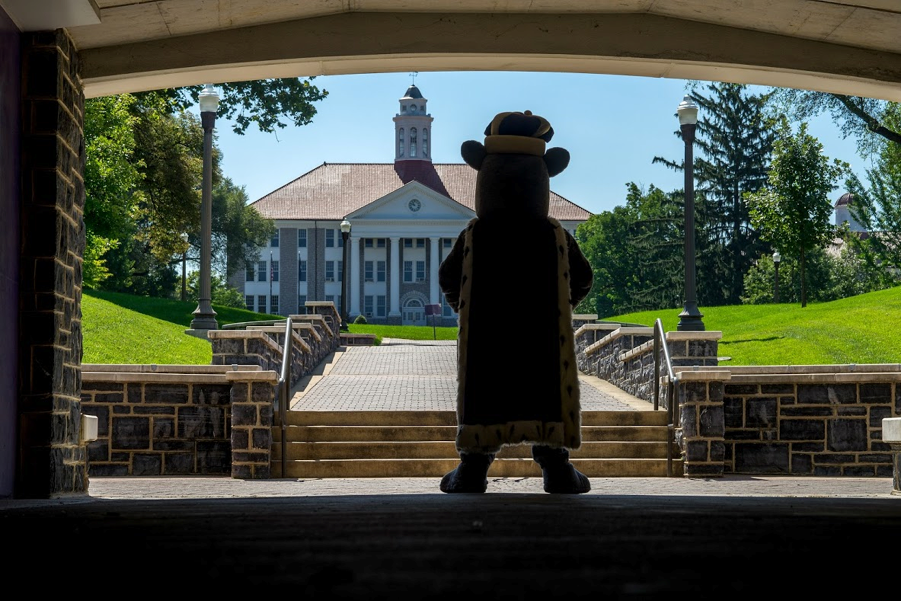
Mission Statement
In support of the mission of James Madison University, the JMU Police Department is dedicated to developing partnerships with the community we serve to enhance the goal of providing quality higher education. We will earn the public's trust through community engagement to:
Support academic freedom; Respect diversity; Protect civil and human rights, and; Provide a safe environment to foster the open exchange of ideas.
We will work collaboratively to prevent crime and disorder through a compassionate and empathetic police department, supporting our students, faculty, and staff in their goals to lead productive and meaningful lives.
Anthony D. Matos, Chief of Police

